Slide 1
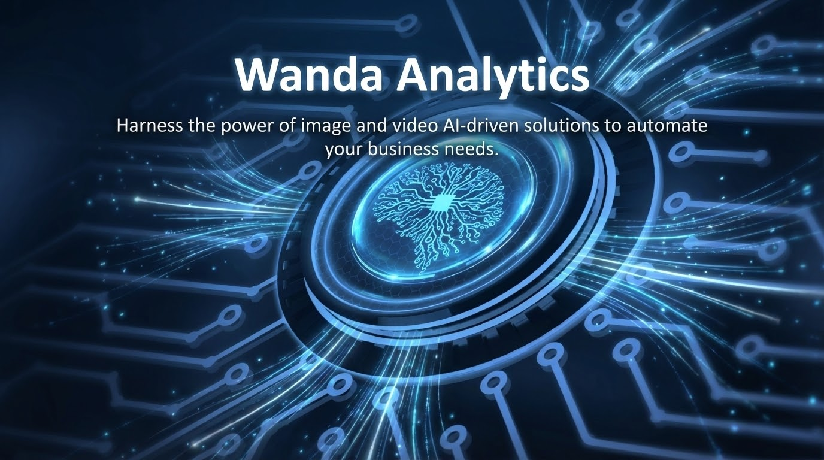

Slide 2
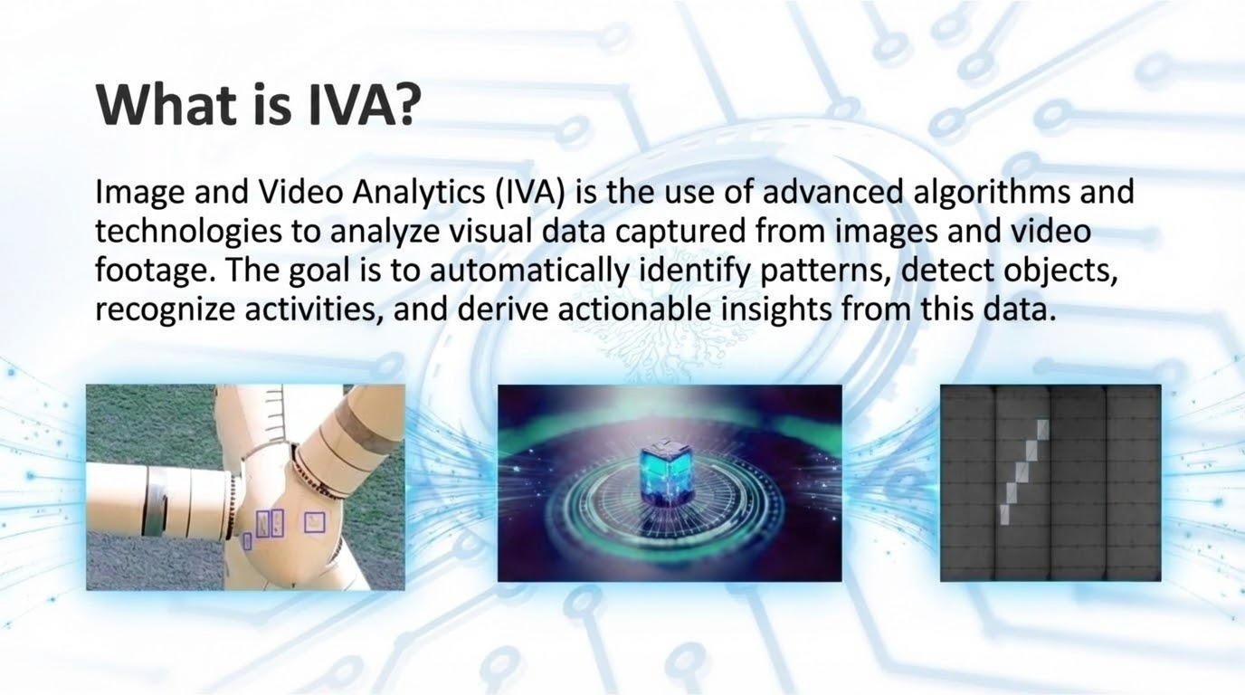

Slide 3
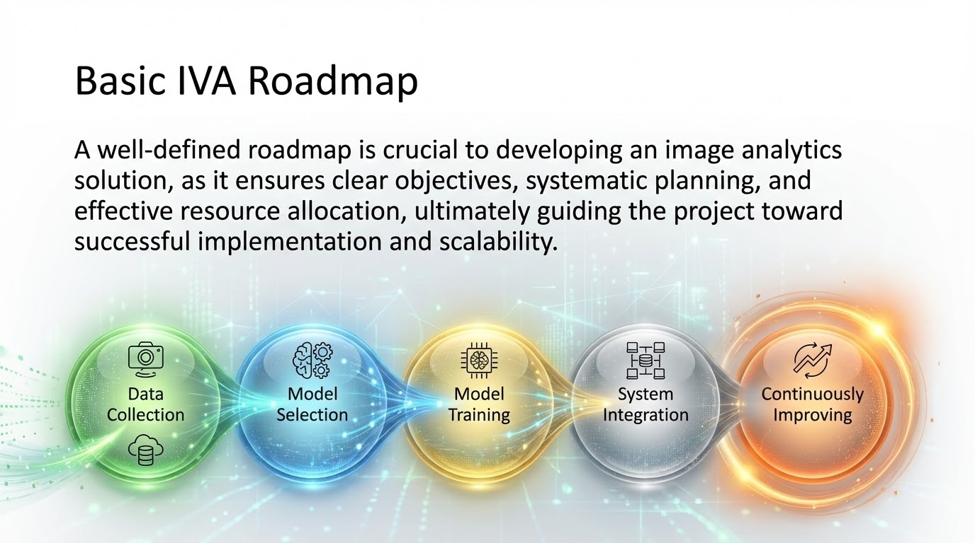

Slide 4
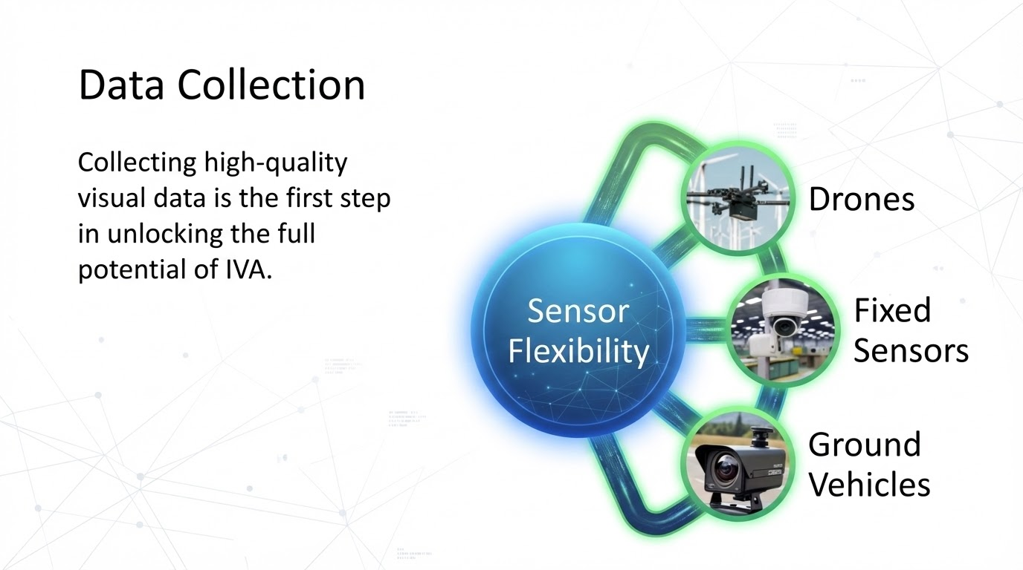

Slide 5
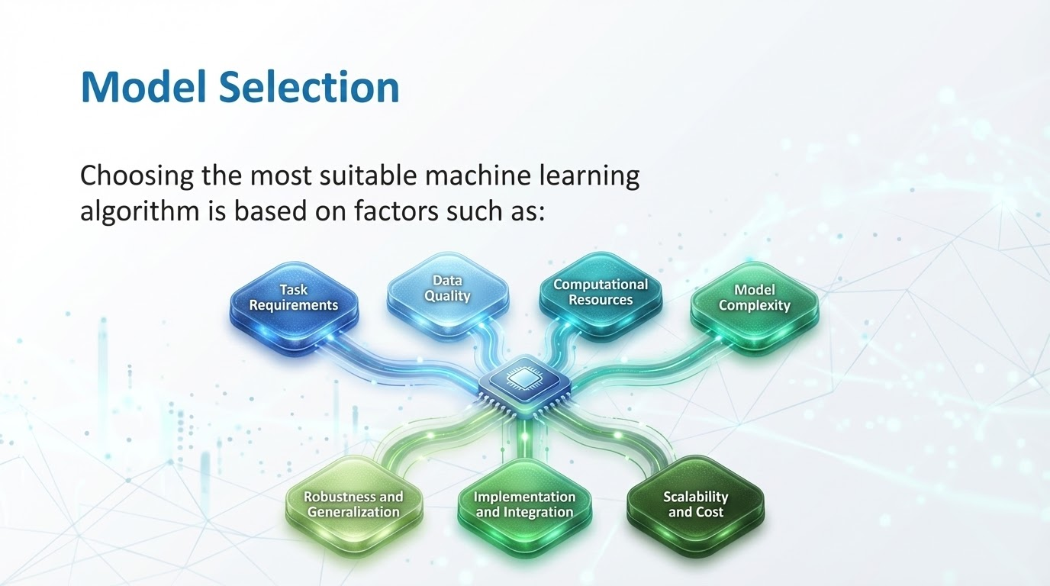

Slide 6
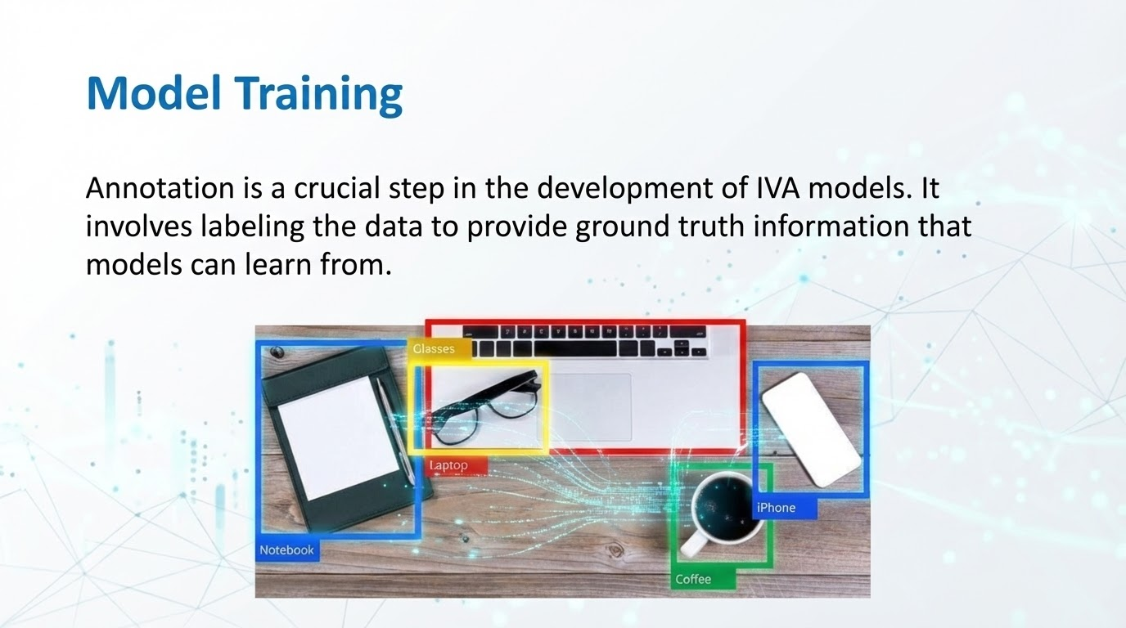
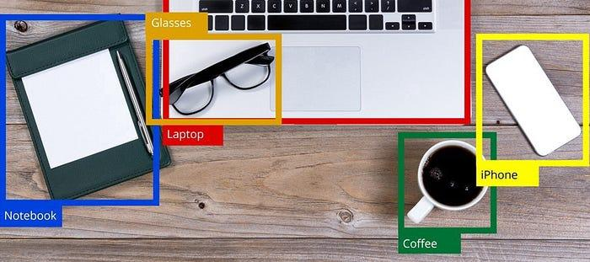

Slide 7
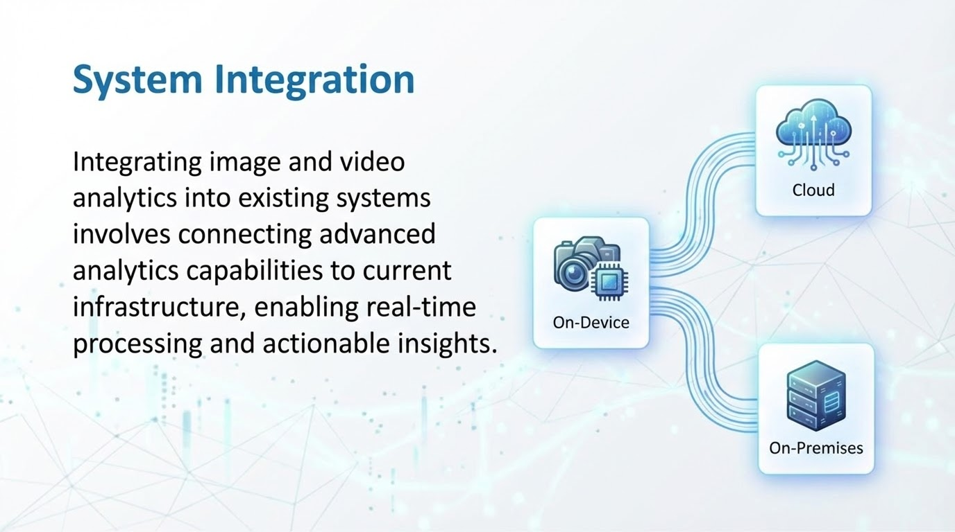

Slide 8
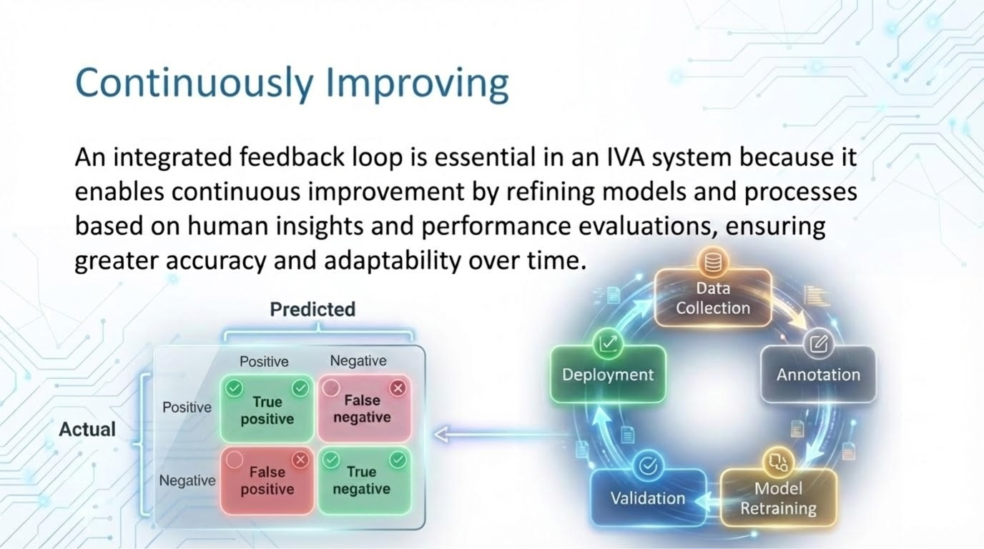

Slide 9
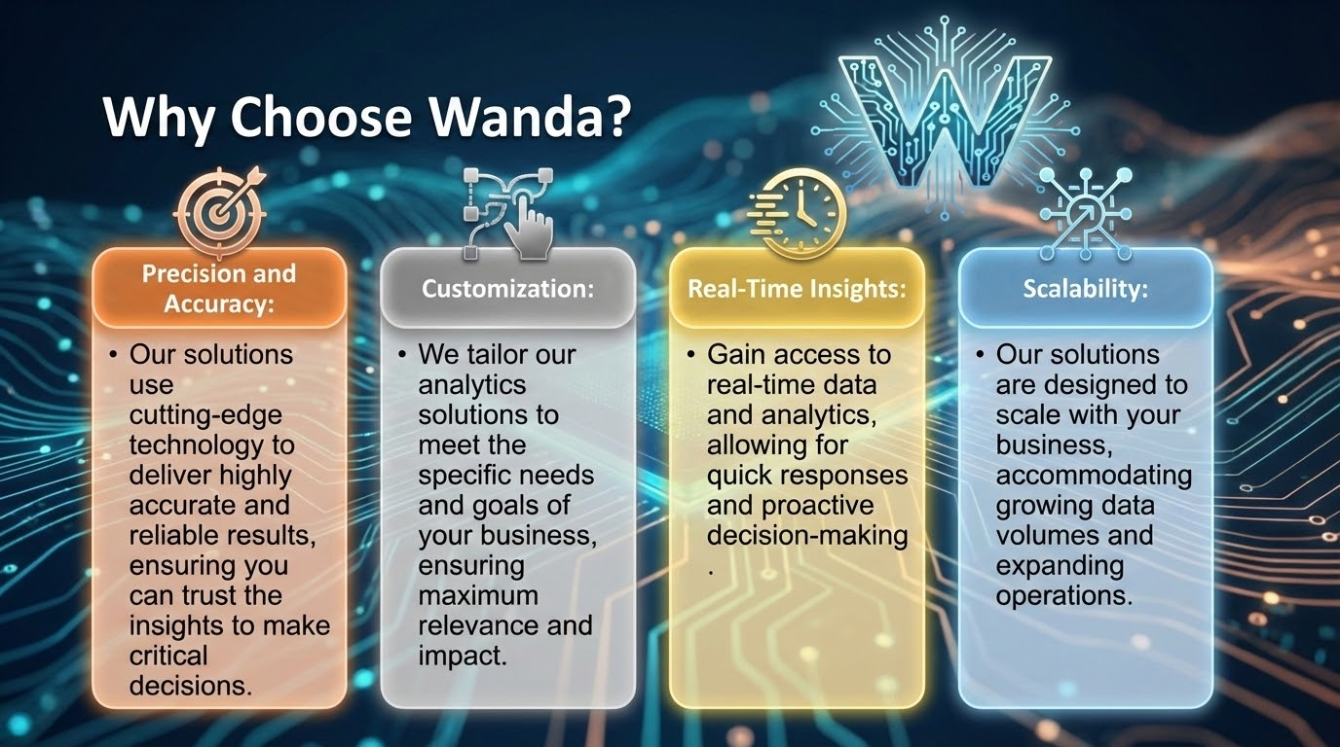

Slide 10

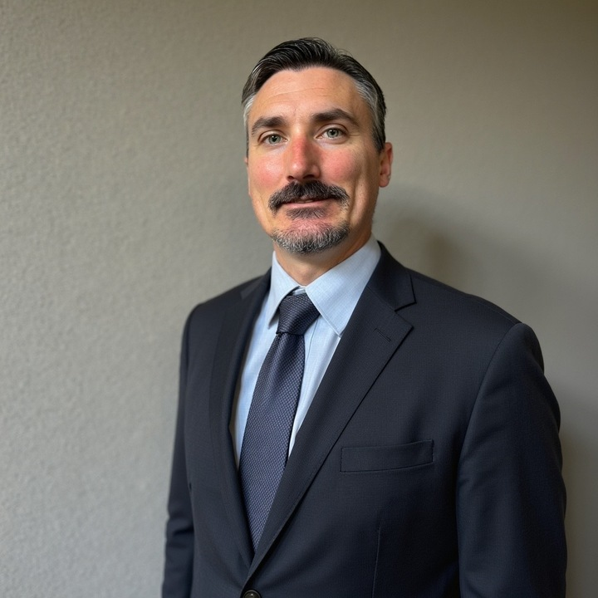
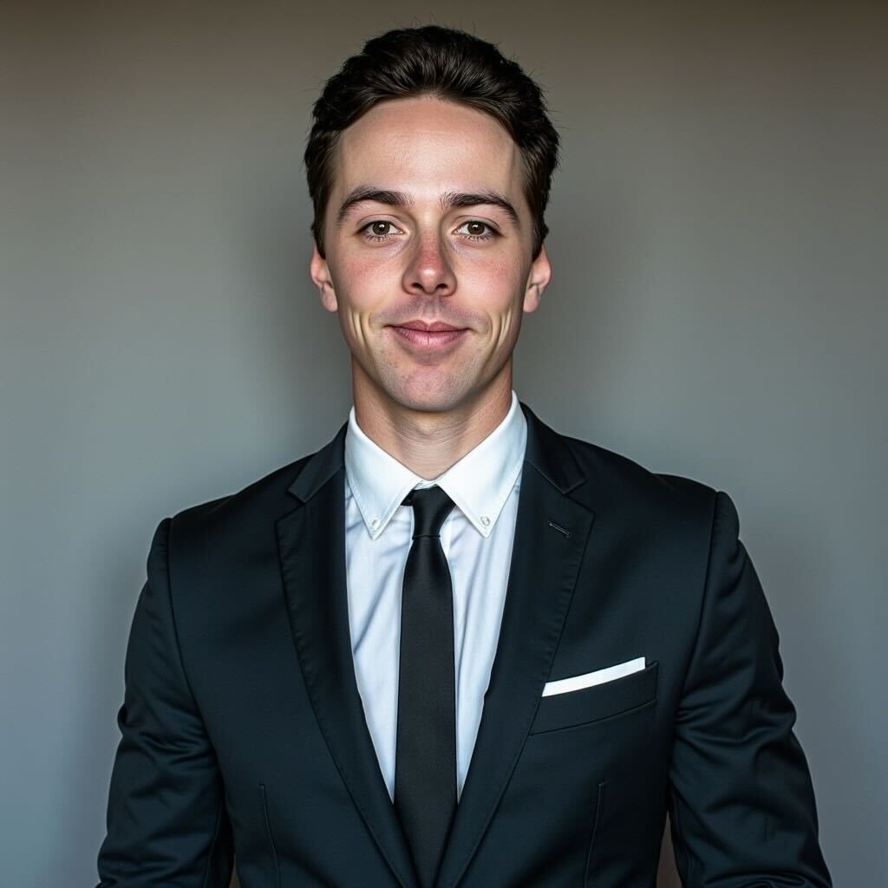
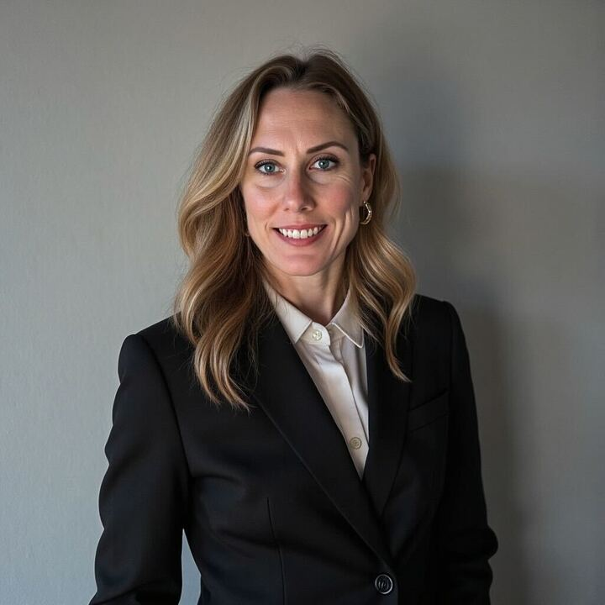
Who Are We?
Bryan Gabric, our Head of Solutions, specializes in image analytics, drone technology, and machine learning. With over a decade of experience leading high-performing teams.
Bowen Kruse, is a technology leader with a distinguished record of delivering innovative solutions in computer vision, machine learning, and operational transformation.
Candice Gabric, is a results-driven professional with a rich history of leadership in technology, data annotation, and engineering

